Slide 1
Section 2.1 Solving for Exponents Worksheet
© Copyright all rights reserved to Homework depot: www.BCMath.ca

Slide 2

Problem: Bill Gates decided to Give you money. The first day he will give you one cent and then double the amount each day. How much money will you receive on the 15th day?
The value on the 15th day can also be found by multiplying “2” over 14 times
© Copyright all rights reserved to Homework depot: www.BCMath.ca

Slide 3
What are Exponents?
Exponents are used to represent the multiplication of a constant over many times
Rather than writing out the same constant over again, we can exponents to simplify the expression
The number at the
top is the Exponent
Write as a single exponent
The entire expression
is a “Power”
ie: 2 to the power of 14
The number in the
bottom is the Base
The base is the number that is being multiplied by
The exponent is how many times you multiply the base
by itself
© Copyright all rights reserved to Homework depot: www.BCMath.ca

Slide 4
I) Review Basic Exponents:
© Copyright all rights reserved to Homework depot: www.BCMath.ca

Slide 5
Powers with Negative bases
If the base has a negative sign within brackets, then the base is negative
If the negative sign is not within brackets or there are no brackets, then the base is positive, with a negative sign in front
The product of two negative bases will become positive
Base is -5
Base is 5, so only the “5” is
squared and not the negative sign
© Copyright all rights reserved to Homework depot: www.BCMath.ca

Slide 6
Ex: Evaluate each of the powers
© Copyright all rights reserved to Homework depot: www.BCMath.ca

Slide 7
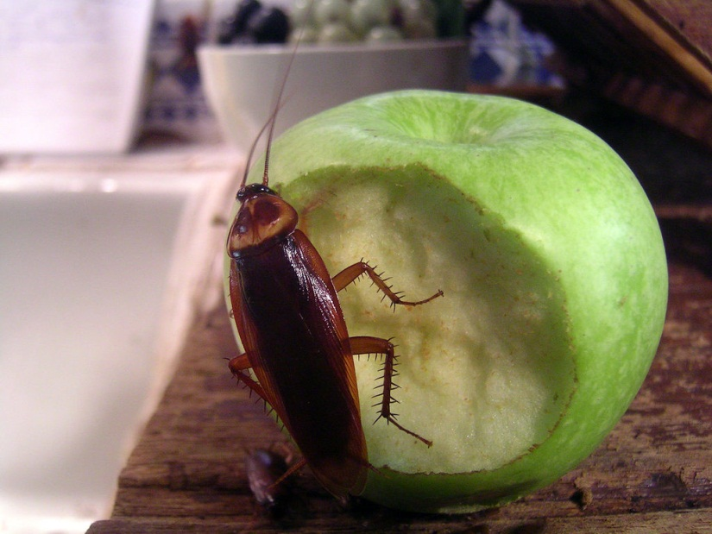
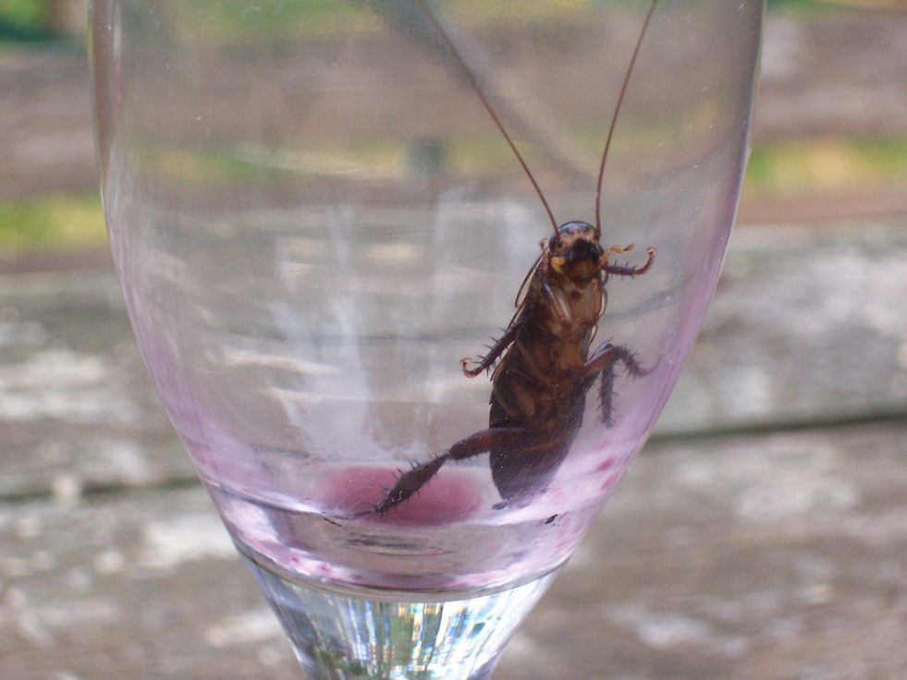
Ex: Cockroach Question:
If a colony of 2 cockroaches doubles every day, how many cockroaches will there be after 1 week?
© Copyright all rights reserved to Homework depot: www.BCMath.ca
© Copyright all rights reserved to Homework depot: www.BCMath.ca

Slide 9
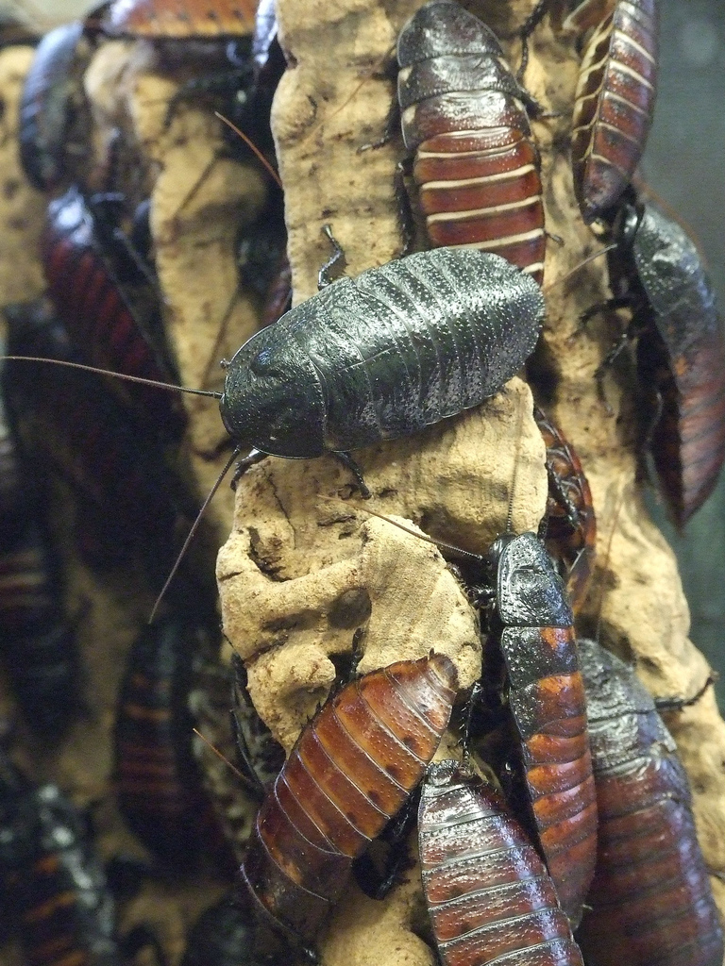
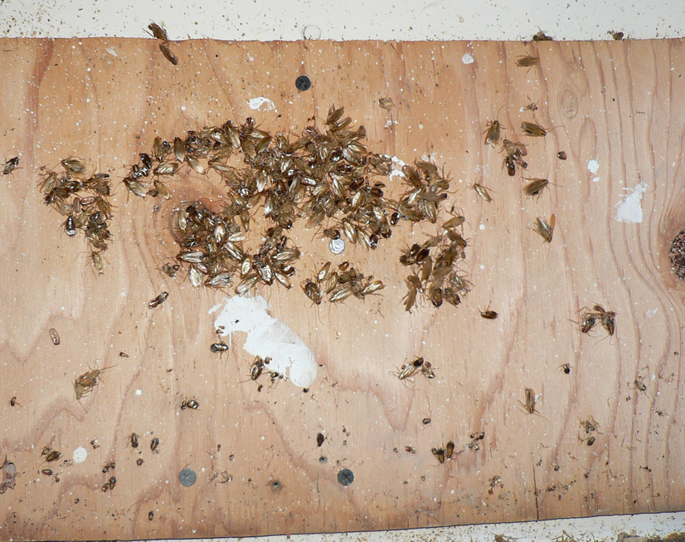
After “7” days, so the
base is multiplied 7 times
How many cockroaches
there was in the beginning
The population “DOUBLES”
each day
© Copyright all rights reserved to Homework depot: www.BCMath.ca

Slide 10
II) Exponent Laws Revisit
© Copyright all rights reserved to Homework depot: www.BCMath.ca

Slide 11
Multiplying Powers
What happens to the exponents when you multiply two powers with the same base?
Each exponent indicates how many bases are in each power
The product of the powers will be the multiplication of all the bases
To find the number of bases, just add the exponents
Note: The powers MUST have the SAME base
Both powers have a base of 5
There are 7 bases in total
Add the exponents
Copyright All Rights Reserved Homework Depot at www.BCMath.ca

Slide 12
Practice: Write each product as a single power
Copyright All Rights Reserved Homework Depot at www.BCMath.ca

Slide 13
Dividing Exponents
What happens when you divide two powers with the same base?
Each base in the denominator will cancel out the bases in the numerator
Subtract the exponents in the bottom from the top
Q: What happens when there are more bases in the bottom?
Ans: You get negative exponents
Cancel out any
Common Factors
in both numerator
and denominator
Copyright All Rights Reserved Homework Depot at www.BCMath.ca

Slide 14
Practice: Write each quotient as a single power
Copyright All Rights Reserved Homework Depot at www.BCMath.ca

Slide 15
Powers to Another Exponent
What happens when you take a power to another exponent?
The outer exponent indicates the number of brackets
The inner exponent indicates the number of bases in each bracket
Multiply the exponent
to count the number of
bases
Copyright All Rights Reserved Homework Depot at www.BCMath.ca

Slide 16
Practice: Rewrite each expression as a single power
Copyright All Rights Reserved Homework Depot at www.BCMath.ca

Slide 17
Simplify each of the following:
Copyright All Rights Reserved Homework Depot at www.BCMath.ca

Slide 18
III) Solving Exponential Equations by Changing the base:
© Copyright all rights reserved to Homework depot: www.BCMath.ca

Slide 19
Practice: Solve the following exponential functions:
© Copyright all rights reserved to Homework depot: www.BCMath.ca

Slide 20
Challenge: Solve for “x”
© Copyright all rights reserved to Homework depot: www.BCMath.ca

Slide 21
Challenge: CNML 1982Find the ordered pair of real numbers (x,y) for which:
Answer:

